Slide 1

Sprocket Central Pty Ltd
Data analytics approach
Rishav Sinha

Slide 2
Agenda
Introduction
Data Exploration
Model Development
Interpretation

Slide 3
Introduction
Identify and recommend Top 1000 Customer to Target from Dataset
Outline of Problem
Sprocket Central is a company that specializes in high-quality bikes and cycling accessories.
Their marketing team is looking to boost business sales by analysing provided datasets.
Using the 3 datasets provided the aim is to analyze and recommend 1000 customers that Sprocket Central should target to drive higher value for the company.
This will be done with the three phases of: Data exploration, Model development and Interpretation
Contents of Data Analysis
New and Old customer age distributions
Bike related purchases over the last 3 years by gender
Job industry distributions
Wealth segmentation by age category
Number of cars owned and not owned by state
RFM analysis and customer classification

Slide 4
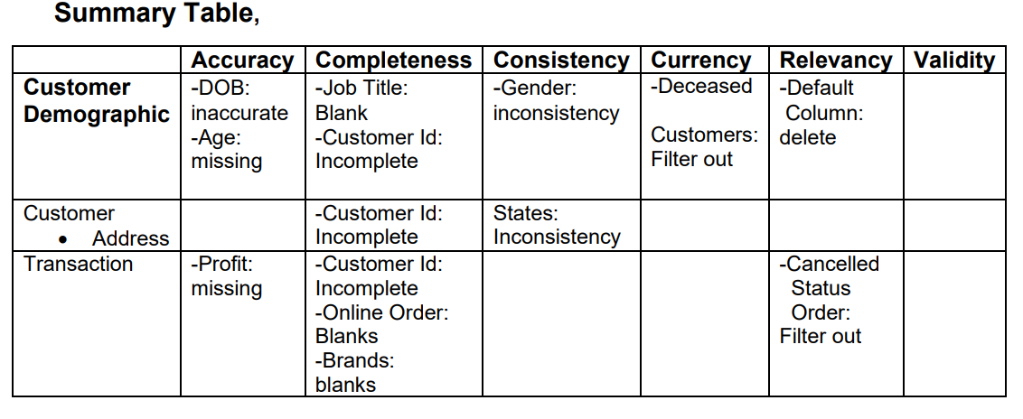
Data Exploration
Data Quality Assessment and ‘Clean Up’
Key Issues for Data Quality Assessment
Accuracy: Correct Values
Completeness: Data fields with values
Consistency: Values up to date
Relevancy: Data items with value Meta-Data
Validity: Data containing Allowable Values
Uniqueness: Records that are Duplicated
An in-depth analysis has been sent via mail.

Slide 5
Data Exploration
‘New’ and ‘Old’ Customer Age Distributions
Most customers are aged between 40-49 in 'New.’ In 'Old' majority of customers are aged between 40-49 also.
The lowest age groups are under 20 and 80+ for both 'New' and 'Old' customer lists
The 'New' customer list suggests that age groups 20-29 and 40-69 are most populated.
• The 'Old' customer list suggests 20-69.
There is a steep drop of customers in the 30-39 age group in 'New.’

Slide 6
Data Exploration
Bike related purchases over last 3 years by gender
Over the last three years about 50% of bike related purchases were made by females to 48% of purchases made by males. Approximately 2% were made by unknown gender
Numerically, females purchases almost 10 000 more than males
Females make up majority of bike related sales

Slide 7
Data Exploration
Job Industry Distribution
20% of 'New' Customers are in Manufacturing and Financial Services.
The smallest number of customers are in Agriculture and Telecommunications at 3%
Similar pattern in 'Old' customer list, at 20% and 19% in Manufacturing and Financial Services respectively

Slide 8
Data Exploration
Wealth Segmentation by age category
In all age categories the largest number of customers are classified as 'Mass Customer
﻿﻿The next category is the 'High Net Worth' customers.
The 'Affluent Customer' can outperforms the 'High Net Worth' customer in the 40-49 age group.

Slide 9
Model Development
Number of cars owned and not owned by state
NSW has the largest amount of people that do not own a car. NSW seems to have a higher number of people from which data was collected.
Victoria is also split quite evenly. But both numbers are significantly lower than those of NSW.
﻿QLD has a relatively high number of customers that own a car.

Slide 10
Interpretation
RMF Segmentation
RMF Analysis is used to determine which customers a business should target to increase its revenue and value.
The RMF model shows customers that have displayed high levels of engagement with the business in the categories.

Slide 11
Appendix

Slide 12
Appendix
All supporting items are in that attachment.

